Slide 1
Drinking Ingredient Catalog
ADS 507 - Practical Data Engineering

Slide 2
Project Objective
Providing a catalog based on the main drinking ingredient
Providing category or country of origin based on ingredient or glass type

Slide 3
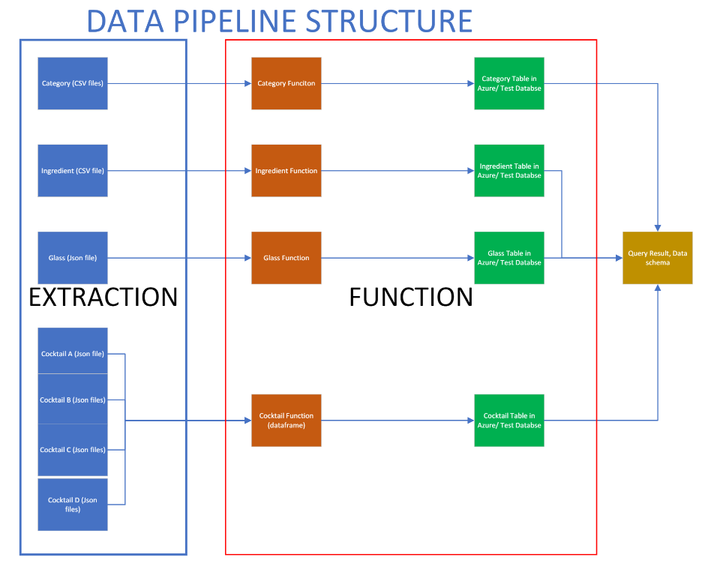
Data Source
4 Datasets:
2 CSV files of Category and Ingredient
2 API files of Glass and drinks
Data is originated from https://www.thecocktaildb.com/api.php
Notes:
Data is extracted from CSV files and json files.

Slide 4
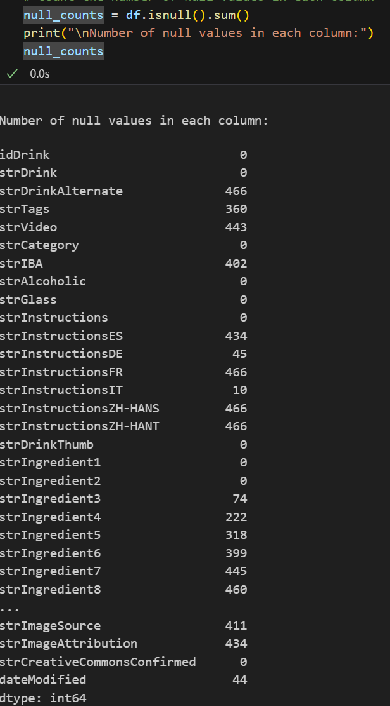
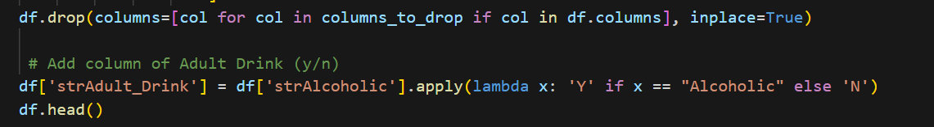
Data Transformation
Columns with Null Values
Columns with Null Values are dropped
Add a new binary column
Notes:
Drink JSON file has null values on some of the attributes which don't add any value to the data. These columns will be dropped from dataframe before it's loaded to database.
Add a new binary column to identify if it’s adult drink

Slide 5
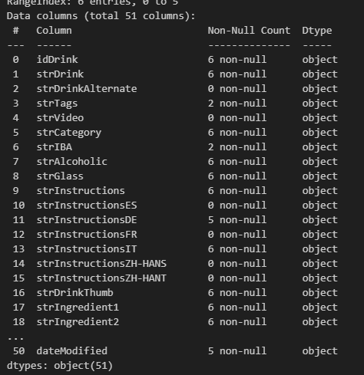
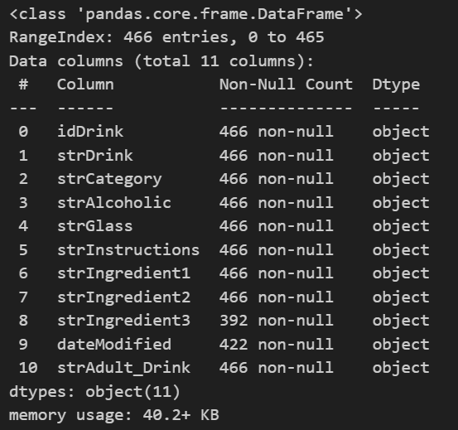
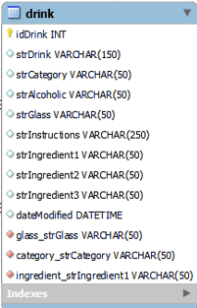
Data Load
Extracted Table
Transformed Dataset
Loaded Dataset

Slide 6
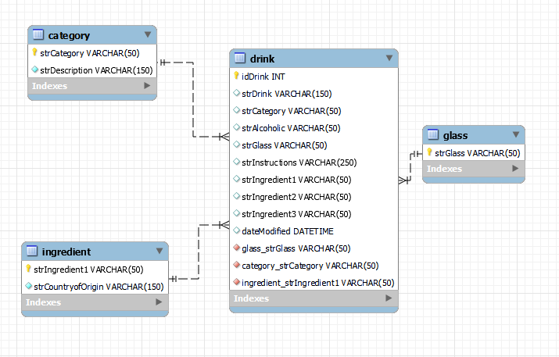
Data Load and Database Schema

Slide 7
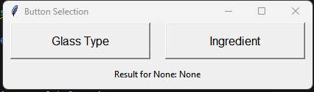
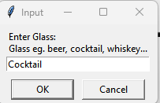
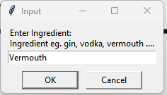
Catalog Entry

Slide 8
Data Strategy Project Proposal Infographics
 | Ceres | Venus | Sun
Mercury | Mercury is a very small planet | 50% | Earth Venus
Mars | Mars is actually a cold place | 75% | Pluto Saturn
Earth | Earth is the third planet from the Sun | 90% | Mars Ceres
Jupiter | Jupiter is the biggest planet of them all | 35% | Jupiter Neptune

Slide 9
Data Strategy Project Proposal Infographics
Jupiter
Pluto
Jupiter is the biggest planet of them all
Pluto is now considered a dwarf planet
2XXX
2XXX
19XX
2XXX
Neptune
Earth
Neptune is the farthest planet from the Sun
Earth is the only planet that harbors life

Slide 10
Data Strategy Project Proposal Infographics
10%
55%
75%
87%
20%
Jupiter
Saturn
Neptune
Mercury
Venus
It's the biggest planet in the Solar System
Saturn is a gas giant and has several rings
Neptune is the farthest planet from the Sun
Mercury is the closest planet to the Sun
Venus is the second planet from the Sun

Slide 11
Data Strategy Project Proposal Infographics
Mars
Despite being red, Mars is a cold place full of iron oxide dust
Earth
Earth is the third planet from the Sun and where we all live
Mercury
Mercury is the closest planet to the Sun and the smallest one
Jupiter
Jupiter is a gas giant and the biggest planet of them all

Slide 12
Data Strategy Project Proposal Infographics
Saturn is a gas giant and has several rings
Neptune is the farthest planet from the Sun
Jupiter is the biggest planet in the Solar System
Mercury is the smallest planet in the Solar System
Ceres is located in the main asteroid belt
Venus is terribly hot, even hotter than Mercury
Solar System

Slide 13
Data Strategy Project Proposal Infographics
50%
75%
Earth
Venus
The Earth is the only planet that harbors life
Venus is the second planet from the Sun

Slide 14
Data Strategy Project Proposal Infographics
Mercury
Earth
Mercury is the closest planet to the Sun
Earth is the planet on which we all live
Neptune
Uranu
Neptune is far away from Earth
Uranus is the seventh planet from the Sun
Venus
Venus is the second planet from the Sun
Jupiter
Jupiter is the biggest planet of them all

Slide 15
Data Strategy Project Proposal Infographics
01
Venus
Venus is terribly hot, even hotter than Mercury
02
Mars
Despite being red, Mars is actually a cold place
03
Saturn
Saturn is a gas giant and has several rings

Slide 16
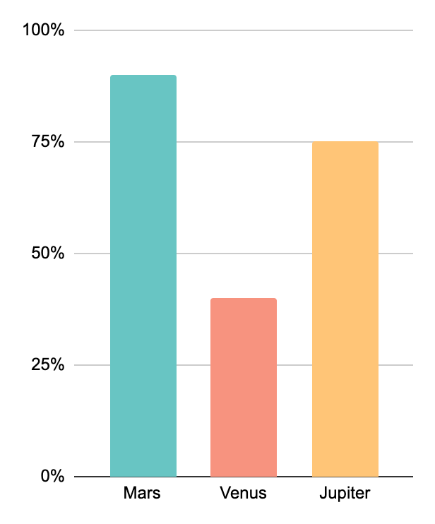
Data Strategy Project Proposal Infographics
90%
Mars
Mars is actually a
cold place
40%
Venus
Venus is the second planet from the Sun
75%
Jupiter
Jupiter is the biggest planet of them all
Follow the link in the graph to modify its data and then paste the new one here. For more info, click here

Slide 17
Data Strategy Project Proposal Infographics
Saturn
Saturn has several rings. It’s a gas giant, mostly composed of hydrogen and helium
Mars
Despite being red, Mars is a cold place. It’s full of iron oxide dust
Jupiter
Jupiter is a gas giant and the biggest planet in the Solar System

Slide 18
Data Strategy Project Proposal Infographics
Jupiter
Jupiter is the biggest planet of them all
Neptune
Mercury
Venus
Neptune is far away from Earth
Mercury is the closest planet to the Sun
Venus is the second planet from the Sun
Saturn is a gas giant and has several rings
Despite being red, Mars is very cold
Uranus is the seventh planet from the Sun

Slide 19
Data Strategy Project Proposal Infographics
Saturn | Venus | Mars
Mercury is a very small planet | 5,000 | Mars is actually a cold place
Mars is actually a cold place | 75,000 | Jupiter is the biggest planet of them all
Earth is the third planet from the Sun | 90,000 | Saturn is a gas giant and has several rings
Jupiter is big

Slide 20
Data Strategy Project Proposal Infographics
25%
50%
Saturn
Jupiter
Saturn is a gas giant and has several rings. It’s composed mostly of hydrogen and helium. It was named after the Roman god of wealth and agriculture
Venus has a beautiful name and is the second planet from the Sun. It’s terribly hot, even hotter than Mercury, and its atmosphere is extremely poisonous

Slide 21
Data Strategy Project Proposal Infographics
01
02
03
04
Venus
Saturn
Jupiter
Mars
Venus is the second planet from the Sun
Saturn is composed of hydrogen & helium
Jupiter is the biggest planet of them all
Mars is actually full of iron oxide dust

Slide 22
Data Strategy Project Proposal Infographics
Earth
Neptune
Earth is the third planet from the Sun
Neptune is very far away from the Sun
Mars
Venus
Despite being red, Mars is a cold place
Venus has a beautiful name

Slide 23
Data Strategy Project Proposal Infographics
The Moon
Ceres | Moon | Pluto | Ceres | Moon
Saturn | Mercury | Júpiter | Venus | Mars
Saturn is a gas giant and has many rings | Mercury is the closest planet to the Sun | Jupiter is the biggest planet of them all | Venus is the second planet from the Sun | Despite being red, Mars is a cold planet
Despite being red, Mars is actually a cold place. It’s full of iron oxide dust, which gives the planet its reddish cast

Slide 24
Data Strategy Project Proposal Infographics
Venus
Venus is the second planet
Jupiter
Jupiter is a very big planet
Mars
Mars is actually a
cold place
Saturn
Saturn is a gas giant with rings

Slide 25
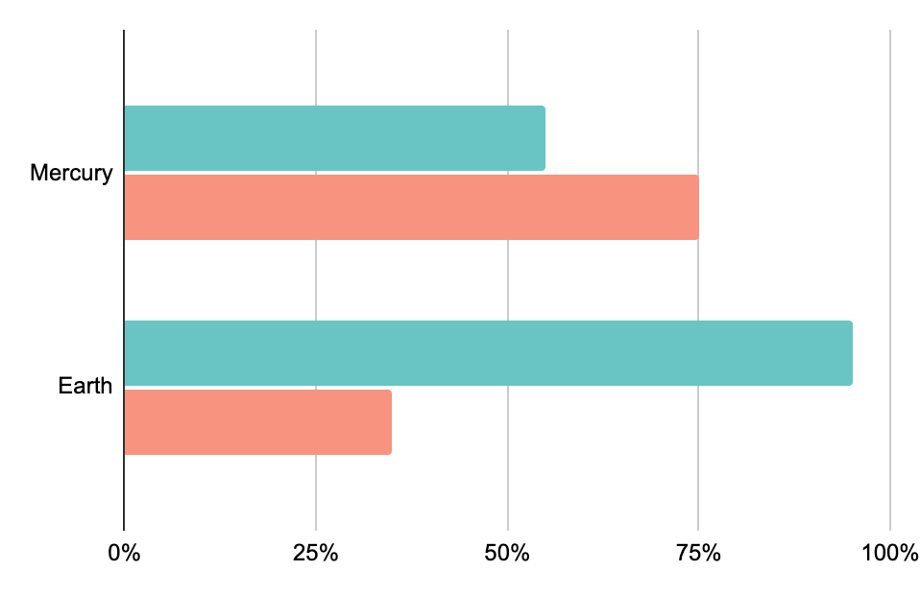
Data Strategy Project Proposal Infographics
Mercury
55%
75%
Mercury is the closest planet to the Sun
Earth
95%
35%
The Earth is the only planet that harbors life
Follow the link in the graph to modify its data and then paste the new one here. For more info, click here

Slide 26
Data Strategy Project Proposal Infographics
Solar System
Jupiter
Mercury
Jupiter is a gas giant and the biggest planet in the Solar System
Mercury is the closest planet to the Sun and the smallest one
Saturn
Venus
Saturn has several rings. It's composed mostly of hydrogen and helium
Venus has a beautiful name and is the second planet from the Sun

Slide 27
Data Strategy Project Proposal Infographics
19XX
2XXX
2XXX
19XX
2XXX
2XXX
We all orbit the Sun
Venus is a warm planet
Saturn has rings
Mercury is a small planet
Jupiter is a big planet
Mars is actually cold

Slide 28
Data Strategy Project Proposal Infographics
65%
Mars
15%
Mars
Despite being red, Mars is actually a cold place
Despite being red, Mars is actually a cold place
95%
Saturn
85%
Venus
Saturn is a gas giant and has many rings
Venus is the second planet from the Sun

Slide 29
Data Strategy Project Proposal Infographics
Earth
Earth has life
Mercury is small
Jupiter is big
Ceres
Venus is hot
Saturn has rings
Saturn
Saturn is a gas giant

Slide 30
Data Strategy Project Proposal Infographics
01
Mercury
03
Venus
05
Saturn
Mercury is the closest planet to the Sun
Venus has extremely high temperatures
Saturn is a gas giant and has several rings
02
Jupiter
04
Neptune
06
Sun
It's a gas giant and the biggest planet
Neptune is a planet far from the Sun
The Sun is the star that we all orbit

Slide 31
Data Strategy Project Proposal Infographics
15%
Earth
Earth is the third planet from the Sun
25%
Mercury
Mercury is the closest planet to the Sun
85%
Venus
Venus has extremely high temperatures

Slide 32
Data Strategy Project Proposal Infographics
Mercury
62%
Mercury is the closest planet to the Sun and the smallest of them all. This planet's name has nothing to do with the liquid metal
Venus
53%
Venus has a beautiful name and is the second planet from the Sun. It’s terribly hot, even hotter than Mercury
Earth
70%
Earth is the third planet from the Sun and the only one that harbors life in the Solar System. This is where we all live

Slide 33
Data Strategy Project Proposal Infographics
Jupiter | Jupiter is a gas giant and the biggest planet of them all | Sun | The Sun is the star at the center of the Solar System
Mercury | Mercury is the closest planet to the Sun and the smallest one | Ceres | Ceres is a planet located in the main asteroid belt
Venus | Venus has a beautiful name, but also high temperatures | Pluto | Pluto is now considered a dwarf planet, not a full-fledged planet

Slide 34
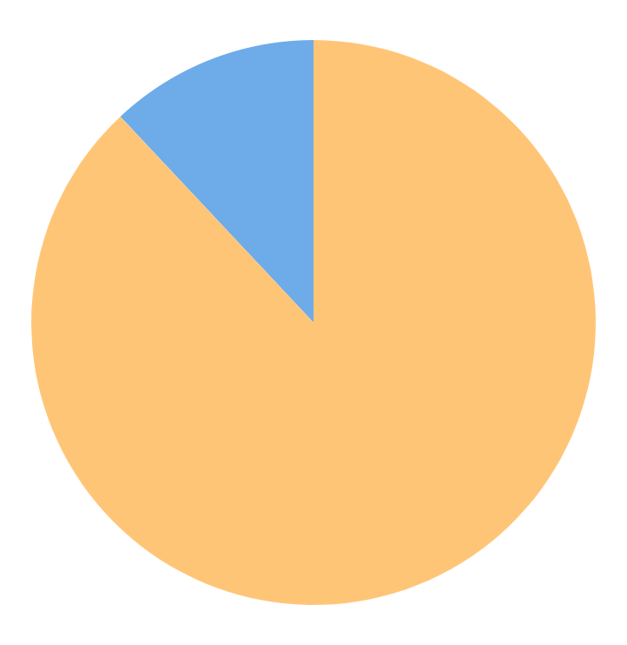
Data Strategy Project Proposal Infographics
Earth
Saturn
Earth is the third planet from the Sun
Saturn is a gas giant and has several rings
12%
88%
Follow the link in the graph to modify its data and then paste the new one here. For more info, click here.

Slide 35
Instructions for use
If you have a free account, in order to use this template, you must credit Slidesgo in your final presentation. Please refer to the next slide to read the instructions for premium users.
As a Free user, you are allowed to:
- Modify this template.
- Use it for both personal and commercial projects.
You are not allowed to:
- Sublicense, sell or rent any of Slidesgo Content (or a modified version of Slidesgo Content).
- Distribute Slidesgo Content unless it has been expressly authorized by Slidesgo.
- Include Slidesgo Content in an online or offline database or file.
- Offer Slidesgo templates (or modified versions of Slidesgo templates) for download.
- Acquire the copyright of Slidesgo Content.
For more information about editing slides, please read our FAQs or visit our blog:
https://slidesgo.com/faqs and https://slidesgo.com/slidesgo-school

Slide 36
Instructions for use (premium users)
As a Premium user, you can use this template without attributing Slidesgo.
You are allowed to:
Modify this template.
Use it for both personal and commercial purposes.
Share this template in an editable format with people who are not part of your team.
You are not allowed to:
Sublicense, sell or rent this Slidesgo Template (or a modified version of this Slidesgo Template).
Distribute this Slidesgo Template (or a modified version of this Slidesgo Template) or include it in a database or in any other product or service that offers downloadable images, icons or presentations that may be subject to distribution or resale.
Use any of the elements that are part of this Slidesgo Template in an isolated and separated way from this Template.
Register any of the elements that are part of this template as a trademark or logo, or register it as a work in an intellectual property registry or similar.
For more information about editing slides, please read our FAQs or visit our blog:
https://slidesgo.com/faqs and https://slidesgo.com/slidesgo-school

Slide 37
Infographics
You can add and edit some infographics to your presentation to present your data in a visual way.
Choose your favourite infographic and insert it in your presentation using Ctrl C + Ctrl V or Cmd C + Cmd V in Mac.
Select one of the parts and ungroup it by right-clicking and choosing “Ungroup”.
Change the color by clicking on the paint bucket.
Then resize the element by clicking and dragging one of the square-shaped points of its bounding box (the cursor should look like a double-headed arrow). Remember to hold Shift while dragging to keep the proportions.
Group the elements again by selecting them, right-clicking and choosing “Group”.
Repeat the steps above with the other parts and when you’re done editing, copy the end result and paste it into your presentation.
Remember to choose the “Keep source formatting” option so that it keeps the design. For more info, please visit our blog.

